Slide 1

MANGALORE UNIVERSITY
Mini Project Report on
“POSE DETECTION USING MEDIAPIPE”
Presented By:
Prathvi Raj
Reg. No :P05AZ21S0022
Under the Guidance of
Dr. B . H . Shekar
Professor
Department of Computer Science
Mangalore University
Mangalagangothri-574199

Slide 2
Content
Introduction
Literature Survey
Proposed System
Implementation
Conclusion And Future Work

Slide 3
ABSTRACT:
Human pose estimation aims at predicting the poses of human body parts in images or videos or real time image.
Human posture recognition is an attractive and challenging topic in computer vision because of its wide range of application main challenge is the detection of the key points in the body.
To resolve this issue, continues research work have been done in this area.
Here we estimate and detect the human pose using Media Pipe and CNN algorithm and using Bottom down approach .

Slide 4
2.INTRODUCTION :
Finding human body joint positions in images or videos is the task of human pose estimation.
By knowing the motion of a human body in a sequence of images, we can know what the person is doing , that is, recognizing the action.
Human pose estimation holds extraordinary potential from single, 2D pictures to aid an extensive variety of uses from the classification of images and recordings etc.
Human posture estimation has always been a challenging problem that acquires great attention.
It involves huge difficulty for the identification and localization of key points of the body that mainly includes various joints and body movement forecast and also shares difficulties in detection
Hence convolutional neural networks have a remarkable approach to image classification and object identification issues.

Slide 5
Objective:
The main objective of HPE is to obtain the person's posture from the given input.
Among different approach for HPE, one approach is called Bottom-up approach .
In the Bottom-up approach, Estimate the human body parts in the image followed by calculating the pose.

Slide 6
Literature Review :
Paper 1:
Paper name: Human Body Pose Estimation and Applications using machine learning approach.
Publish Year : 2021
Authors : Amrutha.K and Prabu.P
In this paper they have explained the method of pose detection using Top-down approach and using R-CNN algorithm . They have collected dataset from MPII Human Pose Dataset.(yt)
Paper 2:
Paper name: Human Pose Estimation and Its Application ,Action Recognition.
Publish Year : 2013
Authors : Gang Yub , Junsong Yuana , Zicheng Liuc
In this paper the author have explained 2D skeleton-based action recognition where the human poses are estimated from regular RGB images instead of depth images . They have collected dataset from COCO.

Slide 7
2. Problem Statement:
The problem consists of human pose estimation. For estimation of human postures, the network takes a raw image , video and real time pose as input and a vector of coordinates of the body key points as outputs.

Slide 8
Proposed system :
The proposed work objective is posed estimation. For the former task, the authors aim to identify x-y pixel coordinates for 32 body joints .
For the latter, they aim to label the images based on the activity category and to estimate the poses using Media Pipe and CNN.
This paper proposes the CNN approach as a solution to human posture estimation problem.
The Media Pipe outputs the pixel coordinate of each body key joints by taking as input a full raw image of (96*96pixels).

Slide 9
Media pipe :
Media Pipe is a deep learning and computer vision-based library for human skeletal posture detection.
It is developed by Google and still is in the experimental phase.
Media Pipe is ideal for real-time yoga posture detection applications as it can achieve good results with low latency.
Media Pipe is that it is platform agnostic. It works on practically any operating system, including desktop, OS, Android, Windows, Linux, etc.
There are alternatives to Media Pipe available like Open Pose, and Blaze poses.
However, compared to others, Media Pipe, a cross-platform solution, is much faster in the face, hand, and pose detection.
It is ideally suited for complex perception pipelines leveraging accelerated inference.

Slide 10
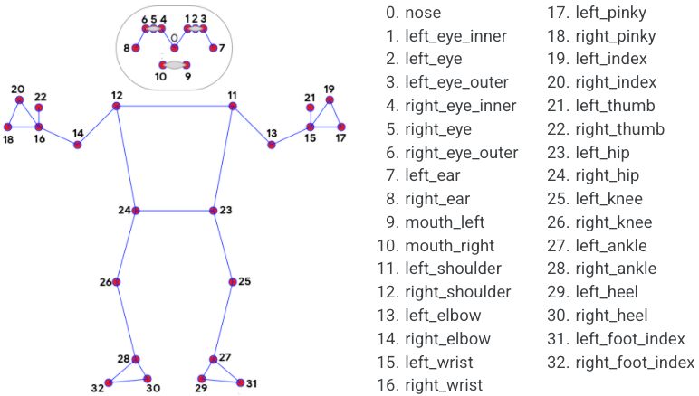
The image shows the thirty-three pose landmarks along with their indexes. Starting with nose to right _ foot _ index.
Figure shows posture detection using Media Pipe.

Slide 11
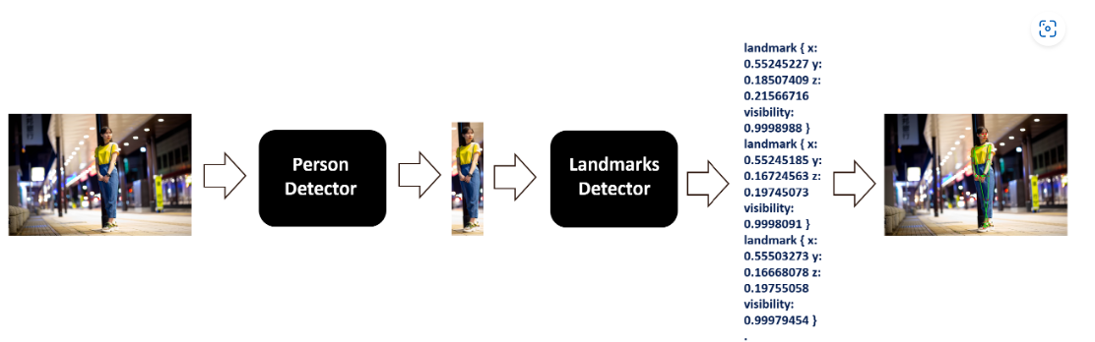
Methodology:
Individual raw images are first extracted from the dataset, then resized and normalized using various Open CV functions .
Then we detect the landmarks using Media pipe library and identify the pose.
Media pipe allow us to use real time computer vision model
It is an open source framework used for media processing .
Media pipe is very fast and it is computational inexpensive,
We can also run Media pipe in any low edge devices.

Slide 12
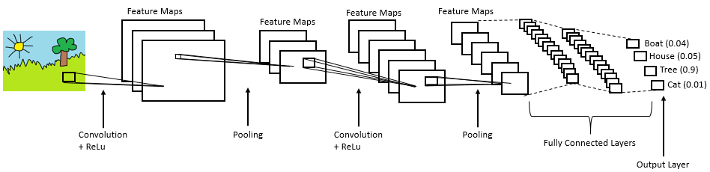
Working of CNN Architecture :

Slide 13
A Convolutional Neural Network (CNN) is a type of deep learning algorithm that is particularly well-suited for image recognition and processing tasks.
It is made up of multiple layers
convolutional layers( Reduce the size of the image ,and it preserves the important features)
pooling layers(In this we take max pixel value in considered image)
fully connected layer(after passing through many combination of both the layers we get different image outputs they are passed to the fully connected layer)

Slide 14
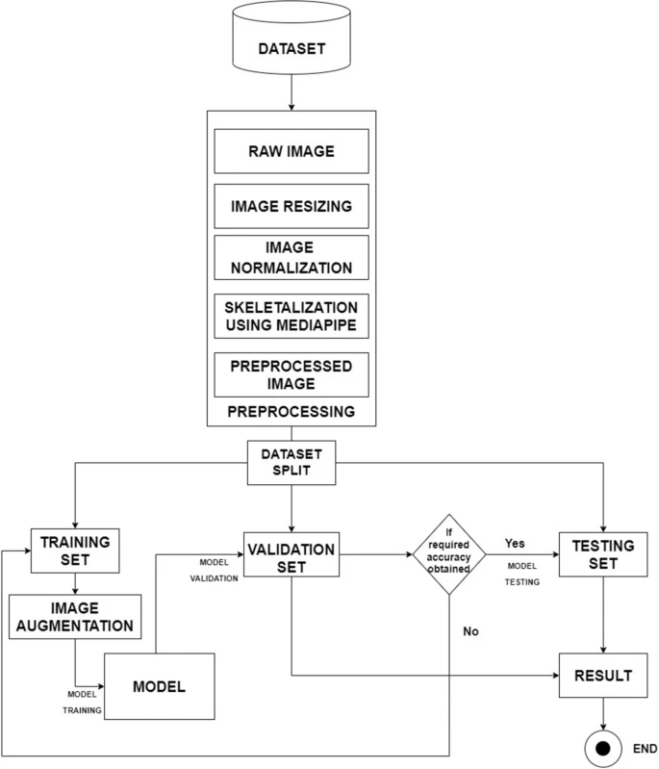
Architecture :
CNN:

Slide 15
The dataset is divided into three parts, training, validation, and testing.
After preprocessing the image set, the training is performed.
Following image augmentation of the dataset, the trained set is passed to the proposed model.
The augmentation step increases the size of the dataset and prevents over fitting.
Subsequently, results are validated and tested using the validation and testing datasets. Finally, results are stored.
A comparative analysis of the results obtained by the existing techniques with the proposed model is added at the end.

Slide 16
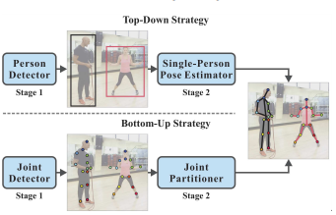
Top-down approach and Bottom down approach
To detect human pose

Slide 17
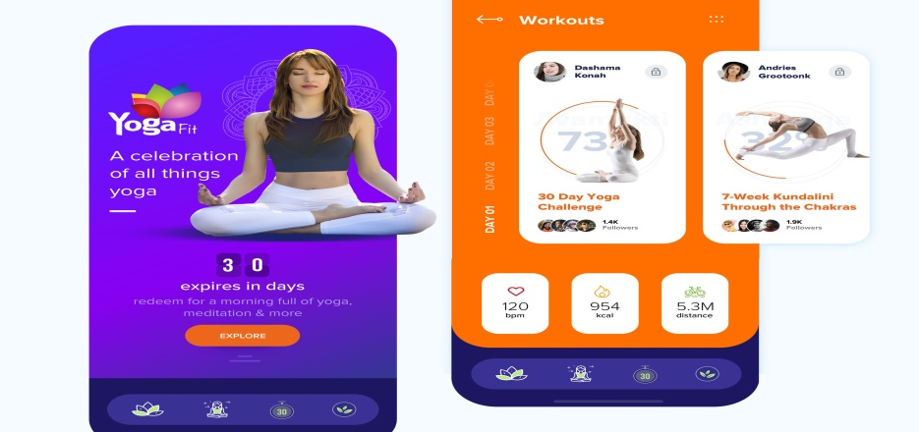
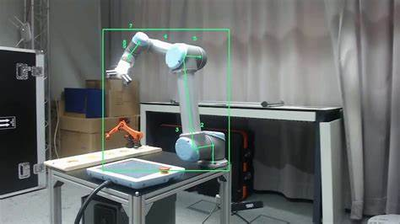
Benefit:
AI-powered personal trainers:
Yoga app, other training app.
Robotics:
Robots can be made to learn actions and movements by following the tutor’s posture, look or appearance.

Slide 18
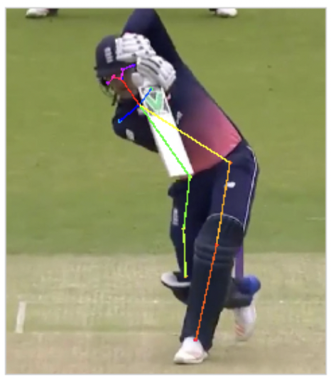
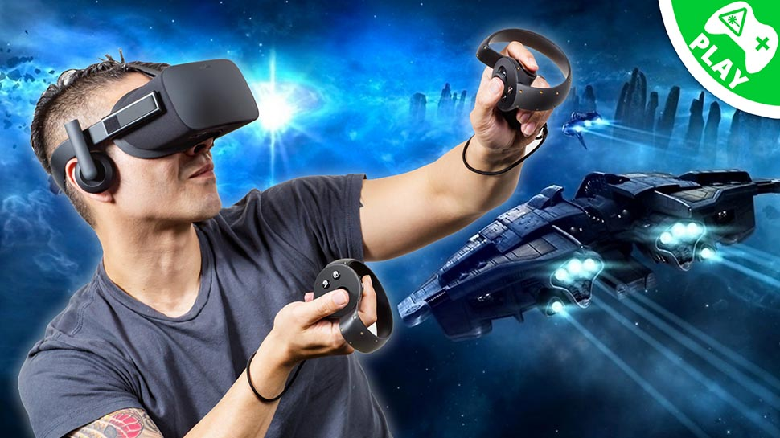
Athlete pose detection:
Pose detection can help players to improve their technique and achieve better results.
Online games.

Slide 19
Challenges :
Human pose estimation is a challenging task as the body’s appearance joins changes dynamically due to diverse forms of clothes, arbitrary occlusion, occlusions due to the viewing angle, and background contexts.
Pose estimation needs to be robust to challenging real-world variations such as lighting and weather. Therefore, it is challenging for image processing models to identify fine-grained joint coordinates.
It is especially difficult to track small and barely visible joints.

Slide 20
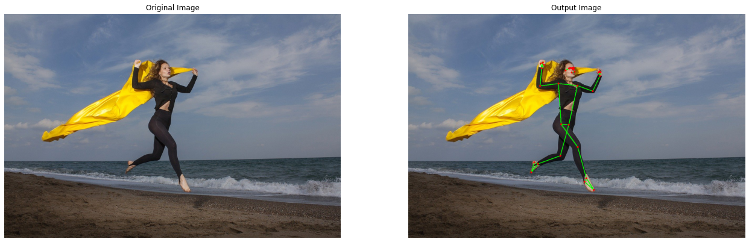
Result:( working of project)
Input : Output:

Slide 21
Conclusion AND Future Work:
In this paper we have presented basic methodology and various applications of Human Pose Estimation
This technology will have considerable implications in shaping and providing a base to many industries such as Virtual reality, Healthcare Industry, Sports/Fitness Industry, and many more.
In this paper, we discussed the implementation of media pipe, Pose to detect human body posture. We came to know how to obtain pose landmarks, configurable ,Outputs, etc.
Future Work:
Estimating pose of a moving person, evaluating the posture in cases of occlusions(inside part) by objects, scanning a human pose beyond an behind a wall, feature extraction from human poses and applications to other dense prediction tasks such as swimming.
One of the main areas where pose estimation can be instrumental is in the sports industry for training and scoring purposes .
virtual judges could score the players based on the accuracy of their posture, movement, gestures, and various other factors (or boxing).

Slide 22
Reference:
Ganesh, Prakhar . “Human Pose Estimation: Simplified.” Medium. Towards Data Science, December 9, 2019.
https:// towardsdatascience.com/human-pose-estimation-simplified-6cfd88542ab3.
Raj, Bharath. “An Overview of Human Pose Estimation with Deep Learning.” Medium. BeyondMinds, May 1, 2019. https://medium.com/beyondminds/an-overview-of-human-pose-estimation-with-deep-learning-d49eb656739b.
J.Carreira, P.Agrawal, K.Fragkiadaki and J. Malik, "Human Pose Estimation with Iterative Error Feedback," 2016 IEEE Conference on Computer Vision and Pattern Recognition (CVPR), Las Vegas, NV, 2016, pp. 4733-4742, doi: 10.1109/CVPR.2016.512.

Slide 23
Xiao, Bin, Haiping Wu and Yichen Wei. “Simple Baselines for Human Pose Estimation and Tracking.” ArXiv abs/1804.06208 (2018): n. pag.
ke, Sun & Xiao, Bin & Liu, Dong & Wang, Jingdong. (2019). Deep High-Resolution Representation Learning for Human Pose Estimation
X. Chen and A. L. Yuille, ‘‘Articulated pose estimation by a graphical model with image dependent pairwise relations,’’ in Proc. NIPS, 2014, pp. 1736–1744.
L. Pishchulin, M. Andriluka, P. Gehler , and B. Schiele ,‘‘Poselet conditioned pictorial structures,’’ in Proc. CVPR, Jun. 2013, pp. 588– 595.
Y. Yang and D. Ramanan, ‘‘Articulated human detection with flexible mixtures of parts,’’ IEEE Trans. Pattern Anal. Mach. Intell., vol. 35, no. 12, pp. 2878–2890, Dec. 2013.

Slide 24
THANK YOU

